Slide 1
Files and Menu Driven Programming Session 11
Course : COMP6056
Effective Period : September 2021

Slide 2
Sub Topics
File input and Output
Processing files
Processing records
Control break logic
Introduction to Menu Driven Programming
Modularizing Menu Driven Program
Using loop to Repeat Menu
Multiple Level Menu

Slide 3
These slides have been adapted from: Gaddis, T. (2019). Starting Out with Programming Logic and Design 5^{th.} ISBN: 978-0-13-480115-5 Chapter 10, 11
Acknowledgement

Slide 4
Learning Objectives
At the end of this lecture, students are able to:
LO1: To explain the purpose of using files.
LO2: To write pseudo-code to solve problem using files and menu driven programming

Slide 5
File Input and Output
When a program needs to save data for later use, it writes the data in a file. The data can be read from the file at a later time.
The programs we have designed so far require the user to reenter data each time the program runs
Programmers usually refer to the process of saving data in a file as “writing data to” the file
Gaddis, T., Starting Out With Programming Logic and Design, 5 ed, ISBN: 978-0-13-480115-5

Slide 6
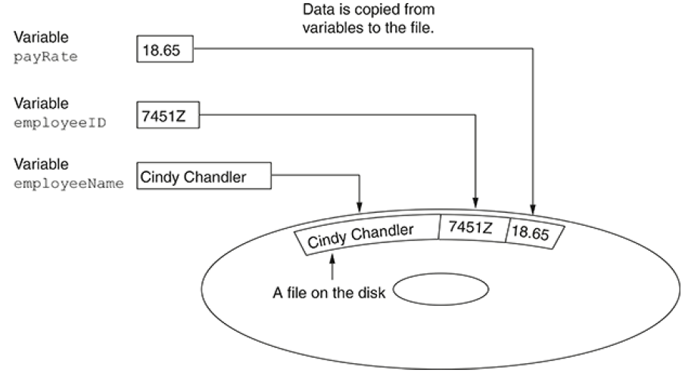
File Input and Output
Writing to a file
Gaddis, T., Starting Out With Programming Logic and Design, 5 ed, ISBN: 978-0-13-480115-5

Slide 7
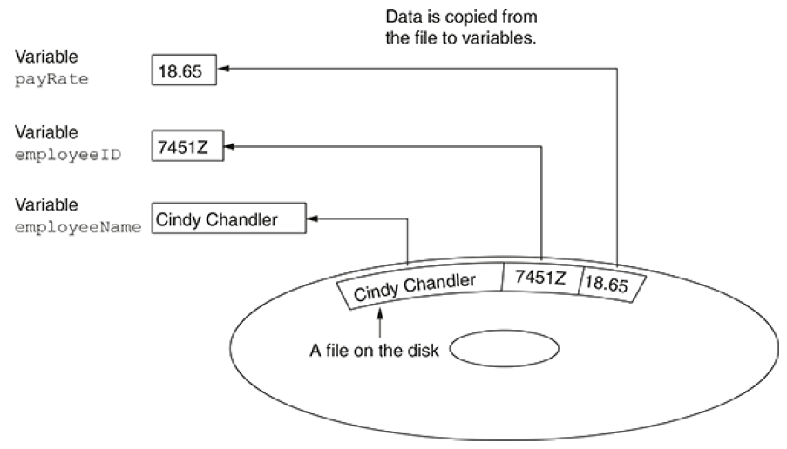
File Input and Output
Reading from a file
Gaddis, T., Starting Out With Programming Logic and Design, 5 ed, ISBN: 978-0-13-480115-5

Slide 8
Types of files
Two types of files: text and binary.
A text file contains data that has been encoded as text, using a scheme such as ASCII or Unicode. Even if the file contains numbers, those numbers are stored in the file as a series of characters. As a result, the file may be opened and viewed in a text editor such as Notepad.
A binary file contains data that has not been converted to text. As a consequence, you cannot view the contents of a binary file with a text editor
Gaddis, T., Starting Out With Programming Logic and Design, 5 ed, ISBN: 978-0-13-480115-5

Slide 9
Processing Files
When writing a program that performs an operation on a file, there are two names that you have to work within the program’s code.
The first of these is the filename that identifies the file on the computer’s disk.
The second is an internal name that is similar to a variable name. In fact, you usually declare a file’s internal name in a manner that is similar to declaring a variable.
Gaddis, T., Starting Out With Programming Logic and Design, 5 ed, ISBN: 978-0-13-480115-5

Slide 10
Processing Files
The following example shows how we declare a name for an output file in our pseudocode
Declare OutputFile customerFile
The word OutputFile indicates the mode in which we will use the file. In our pseudocode, OutputFile indicates that we will be writing data to the file.
The name customerFile is the internal name we will use to work with the output file in our code.
Gaddis, T., Starting Out With Programming Logic and Design, 5 ed, ISBN: 978-0-13-480115-5

Slide 11
Processing Files
Next step is to open the file
Open customerFile "customers.dat"
Writing Data to a File
Write customerFile "Charles Pace"
or
Declare String name = "Charles Pace"
Write customerFile name
Closing an Output File
Close customerFile
Gaddis, T., Starting Out With Programming Logic and Design, 5 ed, ISBN: 978-0-13-480115-5

Slide 12
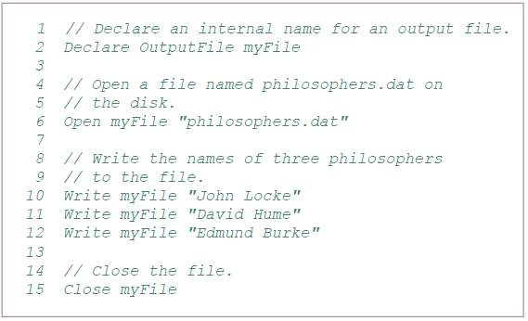
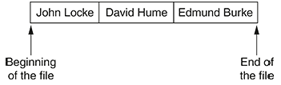
Processing Files
Example
Gaddis, T., Starting Out With Programming Logic and Design, 5 ed, ISBN: 978-0-13-480115-5

Slide 13
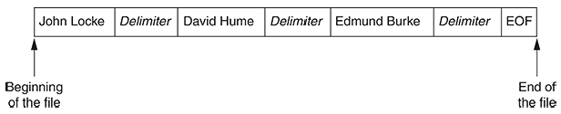
Processing Files
Delimiters and the EOF Marker
Gaddis, T., Starting Out With Programming Logic and Design, 5 ed, ISBN: 978-0-13-480115-5

Slide 14
Processing Files
Reading Data from a File
Declare InputFile inventoryFile
Open inventoryFile "inventory.dat“
Read inventoryFile itemName
Closing the File
Close inventoryFile
Gaddis, T., Starting Out With Programming Logic and Design, 5 ed, ISBN: 978-0-13-480115-5

Slide 15
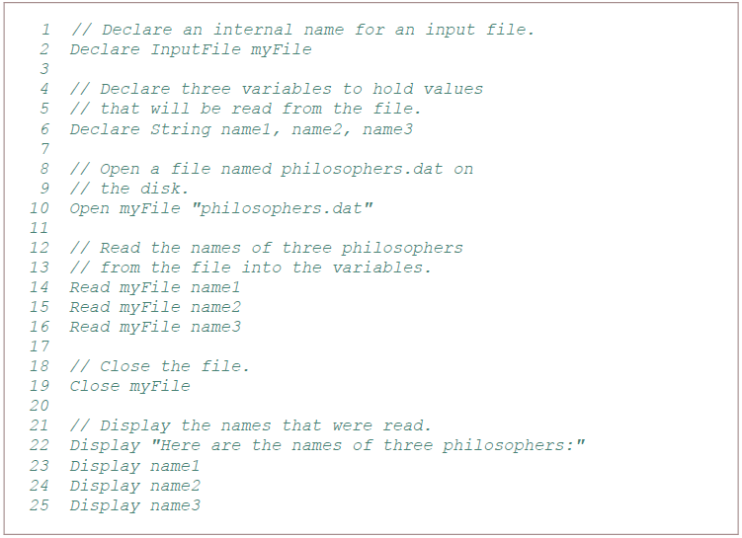
Processing Files
Example
Gaddis, T., Starting Out With Programming Logic and Design, 5 ed, ISBN: 978-0-13-480115-5

Slide 16
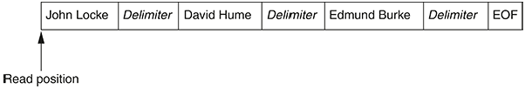
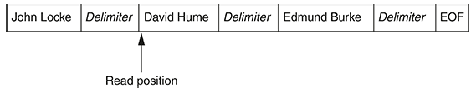
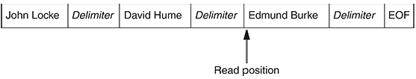
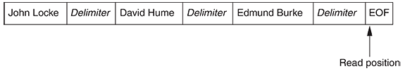
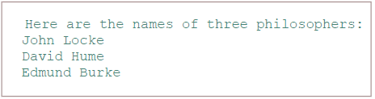
Processing Files
Example
Output
Gaddis, T., Starting Out With Programming Logic and Design, 5 ed, ISBN: 978-0-13-480115-5

Slide 17
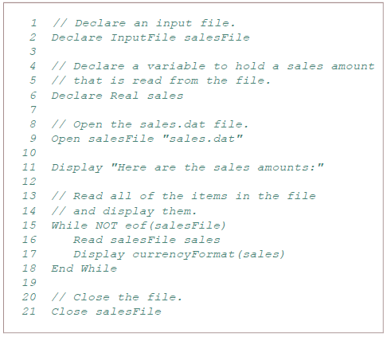
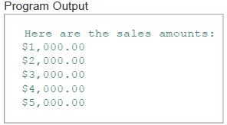
Using Loops to Process Files
Example
Gaddis, T., Starting Out With Programming Logic and Design, 5 ed, ISBN: 978-0-13-480115-5

Slide 18
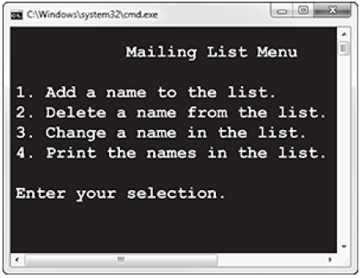
Menu Driven Programming
A menu is a list of operations that are displayed by a program. The user can select one of the operations and the program will perform it.
A menu-driven program displays a list of operations that it can perform on the screen, and allows the user to select the operation that he or she wants the program to perform.
The list of operations that is displayed on the screen is called a menu.
Example:
Gaddis, T., Starting Out With Programming Logic and Design, 5 ed, ISBN: 978-0-13-480115-5

Slide 19
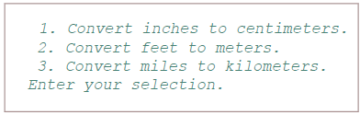
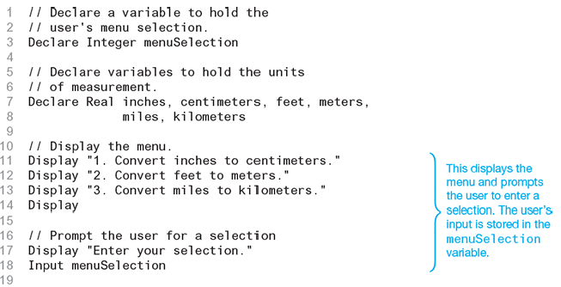
Menu Driven Programming
Gaddis, T., Starting Out With Programming Logic and Design, 5 ed, ISBN: 978-0-13-480115-5

Slide 20
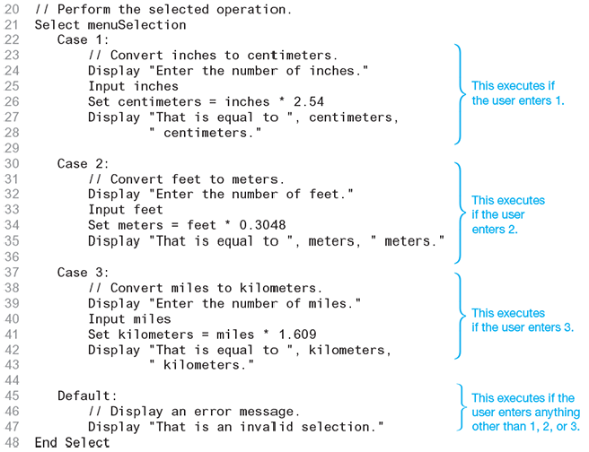
Menu Driven Programming
Gaddis, T., Starting Out With Programming Logic and Design, 5 ed, ISBN: 978-0-13-480115-5

Slide 21
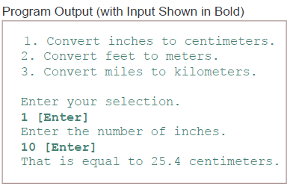
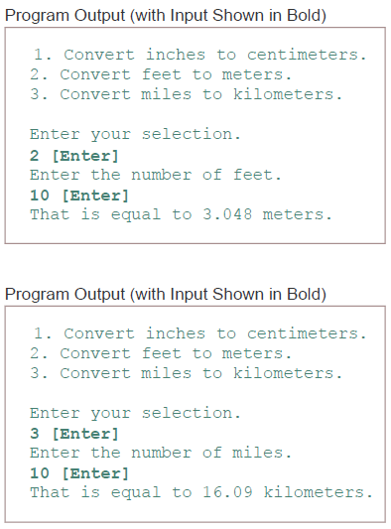
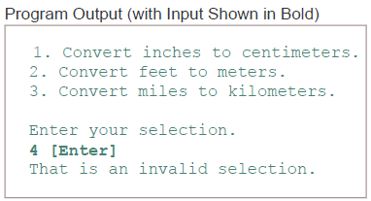
Menu Driven Programming
Gaddis, T., Starting Out With Programming Logic and Design, 5 ed, ISBN: 978-0-13-480115-5

Slide 22
Modularizing a Menu-Driven Program
Menu-driven program is typically capable of performing several tasks, and allows the user to select the task that he or she wants the program to perform.
In most cases, menu-driven programs should be broken down into modules that perform individual tasks
Gaddis, T., Starting Out With Programming Logic and Design, 5 ed, ISBN: 978-0-13-480115-5

Slide 23
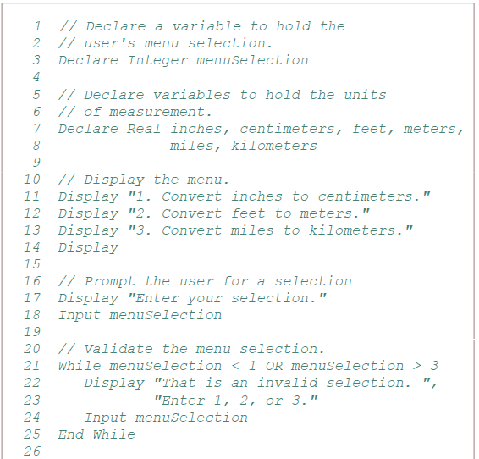
Modularizing a Menu-Driven Program

Slide 24
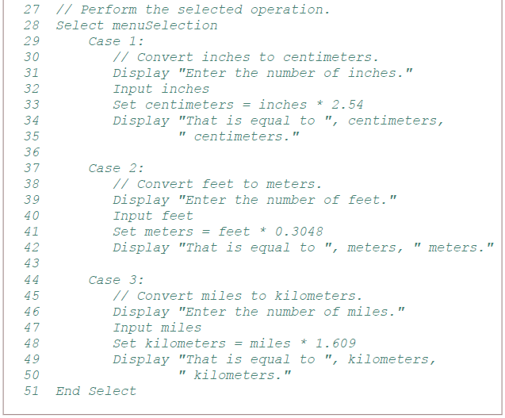
Modularizing a Menu-Driven Program

Slide 25
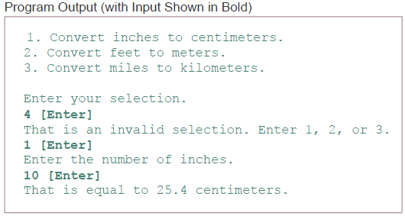
Modularizing a Menu-Driven Program

Slide 26
Modularizing a Menu-Driven Program
main: The main module is the program’s starting point. It calls the other modules.
displayMenu: The displayMenu module displays the menu on the screen, gets the user’s menu selection, and validates it.
inchesToCentimeters: The inchesToCentimeters module prompts the user to enter an amount of inches and displays that amount converted to centimeters. This module is called from the main module (in line 13) when the user enters 1 at the menu prompt.
feetToMeters: The feetToMeters module prompts the user to enter an amount of feet and displays that amount converted to meters. This module is called from the main module (in line 16) when the user enters 2 at the menu prompt.
milesToKilometers: The milesToKilometers module prompts the user to enter an amount of miles and displays that amount converted to meters. This module is called from the main module (in line 19) when the user enters 3 at the menu prompt.
Gaddis, T., Starting Out With Programming Logic and Design, 5 ed, ISBN: 978-0-13-480115-5

Slide 27
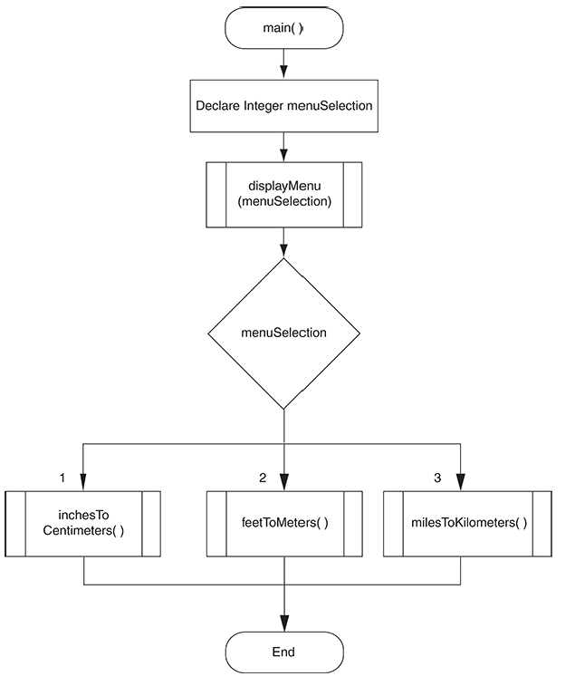
Modularizing a Menu-Driven Program
Gaddis, T., Starting Out With Programming Logic and Design, 5 ed, ISBN: 978-0-13-480115-5

Slide 28
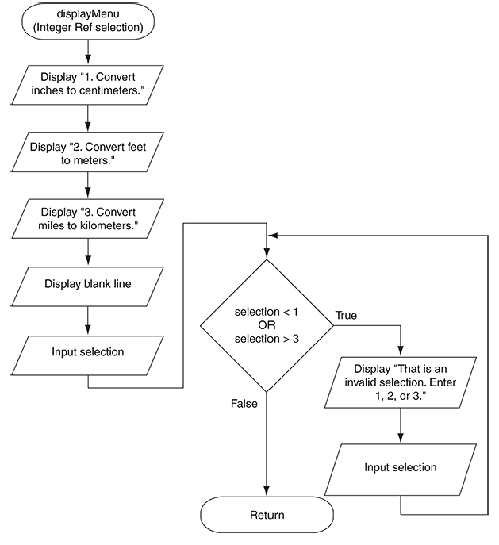
Modularizing a Menu-Driven Program
Gaddis, T., Starting Out With Programming Logic and Design, 5 ed, ISBN: 978-0-13-480115-5

Slide 29
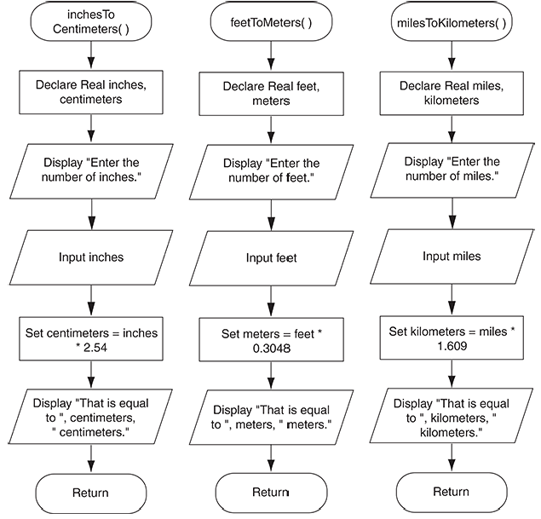
Modularizing a Menu-Driven Program
Gaddis, T., Starting Out With Programming Logic and Design, 5 ed, ISBN: 978-0-13-480115-5

Slide 30
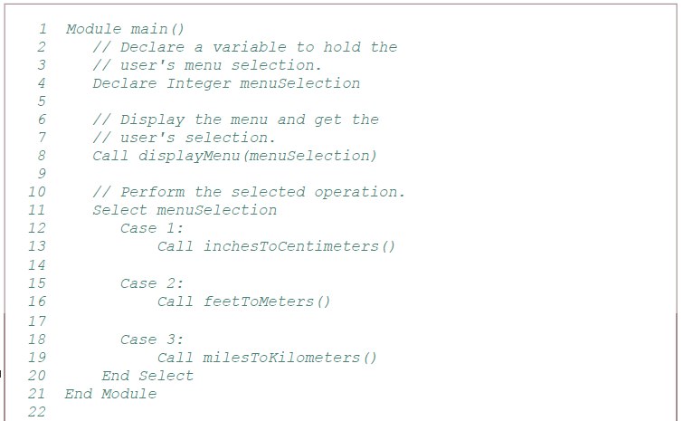
Modularizing a Menu-Driven Program
Gaddis, T., Starting Out With Programming Logic and Design, 5 ed, ISBN: 978-0-13-480115-5

Slide 31
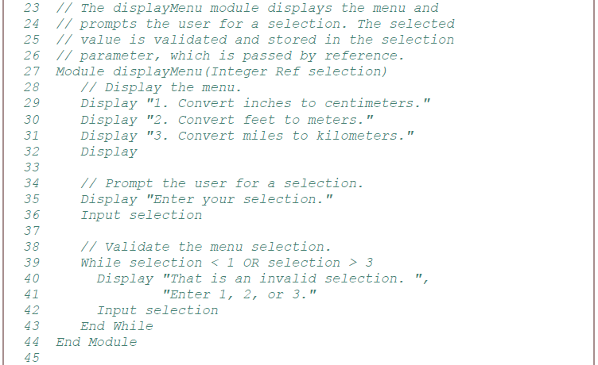
Modularizing a Menu-Driven Program
Gaddis, T., Starting Out With Programming Logic and Design, 5 ed, ISBN: 978-0-13-480115-5

Slide 32
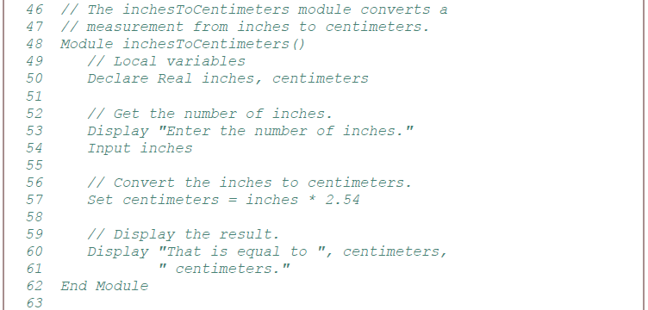
Modularizing a Menu-Driven Program
Gaddis, T., Starting Out With Programming Logic and Design, 5 ed, ISBN: 978-0-13-480115-5

Slide 33
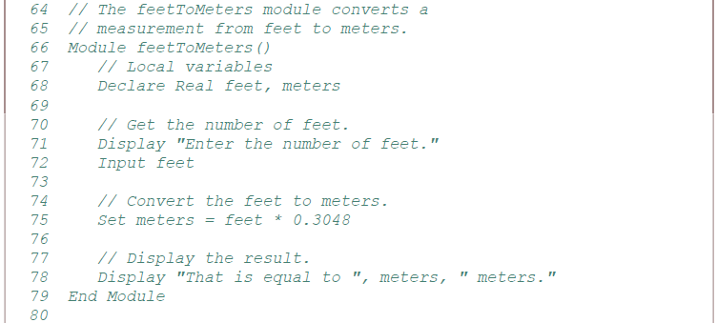
Modularizing a Menu-Driven Program
Gaddis, T., Starting Out With Programming Logic and Design, 5 ed, ISBN: 978-0-13-480115-5

Slide 34
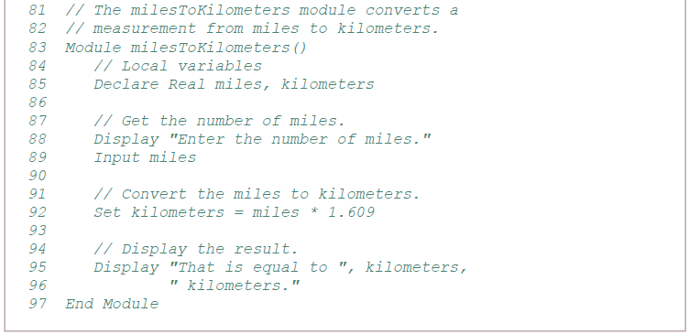
Modularizing a Menu-Driven Program
Gaddis, T., Starting Out With Programming Logic and Design, 5 ed, ISBN: 978-0-13-480115-5

Slide 35
Multi-Level Menu
A multiple-level menu has a main menu and one or more submenus
Example:
1. Process a sale
2. Process a return
3. Add a record to the inventory file
4. Search for a record in the inventory file
5. Modify a record in the inventory file
6. Delete a record in the inventory file
7. Print an inventory list report
8. Print a list of inventory items by cost
9. Print a list of inventory items by age
10. Print a list of inventory items by retail value
There are so many items in this list, you probably shouldn’t display them all in one menu.
Users often have trouble sorting through the items in a menu when given too many choices
Gaddis, T., Starting Out With Programming Logic and Design, 5 ed, ISBN: 978-0-13-480115-5

Slide 36
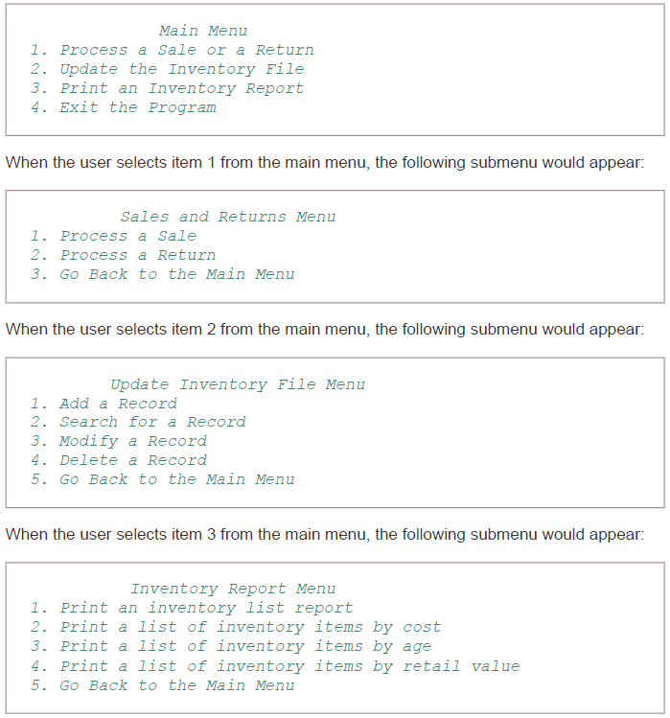
Multi-Level Menu
Using multiple level menu
Gaddis, T., Starting Out With Programming Logic and Design, 5 ed, ISBN: 978-0-13-480115-5

Slide 37
References
Gaddis, T. (2019). Starting Out with Programming Logic and Design 5th. ISBN: 978-0-13-480115-5

